Slide 1
AI/ML WORKSHOP PROJECT
Heart Failure Prediction
Using Machine Learning Models
Aditya Jha
23FE10CSE00767
Dataset: Kaggle Heart Failure Prediction | 918 records • 12 features • Binary Classification

Slide 2
01 / Introduction
17.9M
#1
918
12
Deaths/year
from CVD globally
Cause of
mortality worldwide
Patient records
in this dataset
Clinical features
analyzed
Problem Statement
Project Objective
• Heart failure is a critical CVD condition with high mortality rates worldwide.
• Traditional diagnostics depend on physician expertise — prone to subjectivity.
• Machine learning can discover non-linear clinical patterns beyond human intuition.
• Early, accurate prediction can save lives and optimize healthcare resources.
• Develop a binary classification framework to predict heart disease presence.
• Compare Logistic Regression vs. Random Forest on identical experimental conditions.
• Evaluate using Accuracy, Precision, Recall, F1-Score, and ROC-AUC.
• Derive clinically meaningful insights from confusion matrices and ROC curves.

Slide 3
02 / Dataset & Features
Dataset Info
Feature
Type
Description
Age
Numerical
Patient age in years
Source
Kaggle / fedesoriano
Sex
Categorical
M / F
Records
918 patients
ChestPainType
Categorical
ATA, NAP, ASY, TA
RestingBP
Numerical
Resting BP (mm Hg)
Features
12 clinical variables
Cholesterol
Numerical
Serum cholesterol (mg/dl)
Target
HeartDisease (0/1)
FastingBS
Binary
Blood sugar > 120 mg/dl
Positive
508 cases (55.3%)
RestingECG
Categorical
ECG results
Negative
410 cases (44.7%)
MaxHR
Numerical
Max heart rate achieved
ExerciseAngina
Categorical
Exercise-induced angina
Split
80% train / 20% test
Oldpeak
Numerical
ST depression (exercise)
Encoding
One-Hot (categorical)
ST_Slope
Categorical
ST segment slope
Scaling
StandardScaler
HeartDisease
Target ★
1 = Disease, 0 = Normal

Slide 4
03 / Methodology
01
Data Loading
02
Data Cleaning
03
Encoding
04
Scaling
05
Train-Test Split
Read heart.csv (918 rows, 12 cols). Inspect dtypes, check missing values.
Replace invalid zeros in Cholesterol, RestingBP, MaxHR, Oldpeak with column median.
One-Hot Encode: Sex, ChestPainType, RestingECG, ExerciseAngina, ST_Slope.
StandardScaler applied to all features (zero mean, unit variance).
80/20 stratified split → 734 train, 184 test. random_state=42.
▶
▶
▶
▶
Models Implemented
Logistic Regression
Random Forest Classifier
Solver: L-BFGS • max_iter=1000 • Linear decision boundary • Probabilistic output • Statistical baseline
n_estimators=100 • random_state=42 • Ensemble of decision trees • Non-linear boundary • Implicit feature selection

Slide 5
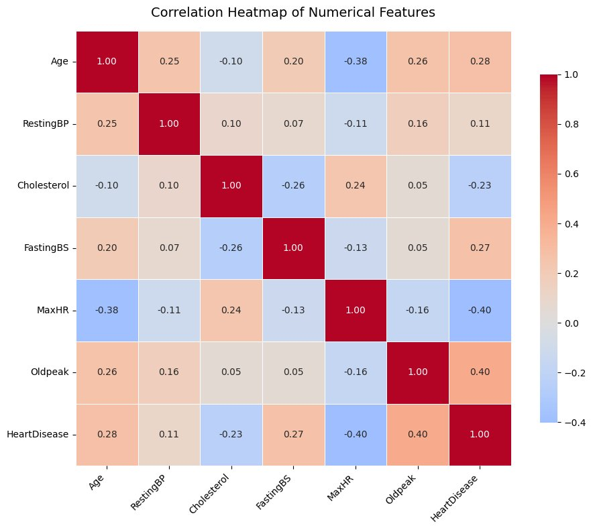
04 / EDA — Correlation Heatmap
Key Observations
MaxHR ↔ HeartDisease
Strong negative (-0.40): higher max HR → lower disease risk
Oldpeak ↔ HeartDisease
Strong positive (+0.40): higher ST depression → higher risk
FastingBS ↔ HeartDisease
Moderate positive (+0.27): elevated fasting sugar linked to disease
Age ↔ HeartDisease
Moderate positive (+0.28): older patients more at risk
Cholesterol ↔ HeartDisease
Weak negative (-0.23): after zero-imputation, limited linear signal
Age ↔ MaxHR
Moderate negative (-0.38): expected physiological decline with age

Slide 6
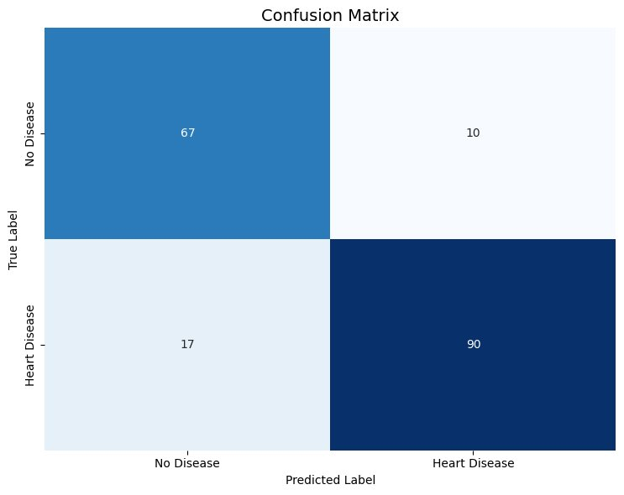
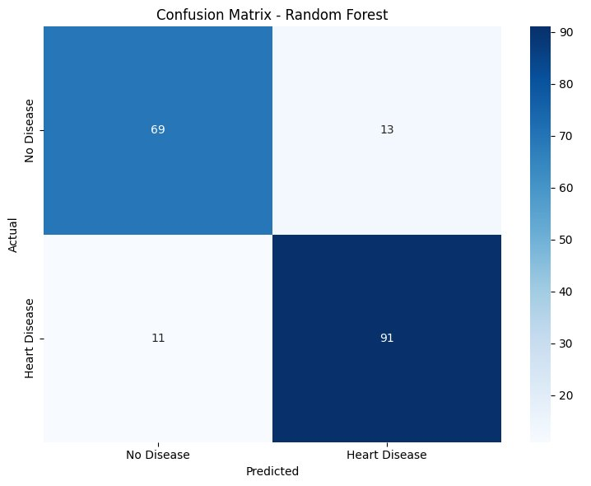
05 / Results — Confusion Matrices
Logistic Regression
Random Forest
TN: 67 | FP: 10 | FN: 17 | TP: 90 → Accuracy: 85.3%
TN: 69 | FP: 13 | FN: 11 | TP: 91 → Accuracy: 87.0%

Slide 7
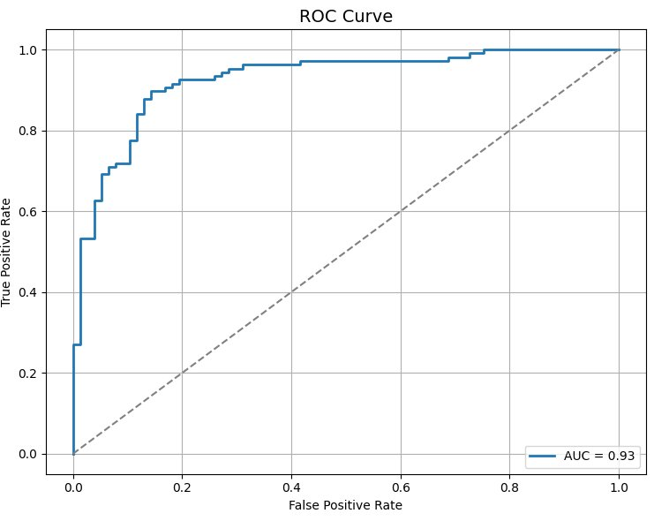
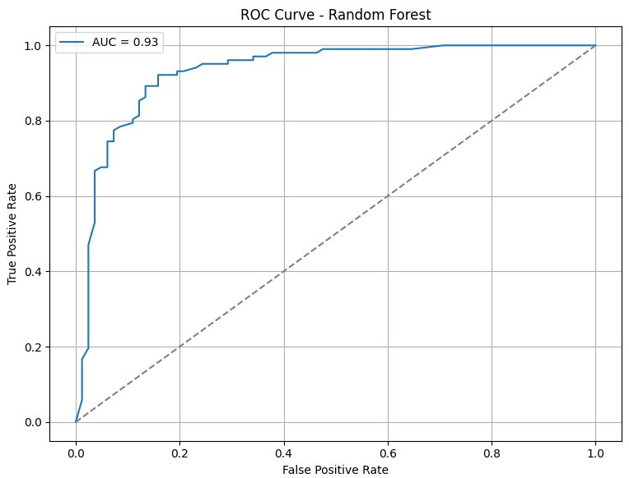
06 / Results — ROC Curves & Metrics
Logistic Regression (AUC = 0.93)
Random Forest (AUC = 0.93)
Model
Accuracy
Precision
Recall
F1-Score
AUC
Logistic Regression
85.3%
0.90
0.84
0.87
0.93
Random Forest
87.0%
0.88
0.89
0.88
0.93

Slide 8
KEY FINDINGS & CONCLUSION
Conclusion
Best Model
Accuracy
ROC-AUC
Recall
Random Forest
87.0%
0.93
0.89
Outperforms LR across all metrics
vs 85.3% for Logistic Regression
Both models — strong discrimination
RF detects more true disease cases
Takeaways
Random Forest captures non-linear interactions between clinical features that Logistic Regression's linear boundary cannot represent.
False Negatives (missed heart disease cases) are lower in RF (11 vs 17) — a critical clinical safety advantage.
Both models achieve AUC = 0.93, confirming strong discriminative capacity on this near-balanced dataset.
Logistic Regression remains valuable where model interpretability or regulatory transparency is required.
Future Scope: XGBoost / LightGBM • SHAP Explainability • Hyperparameter Tuning • Cross-dataset Validation

